Slide 1
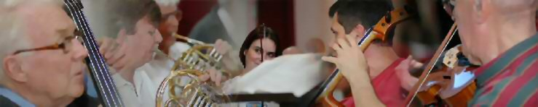

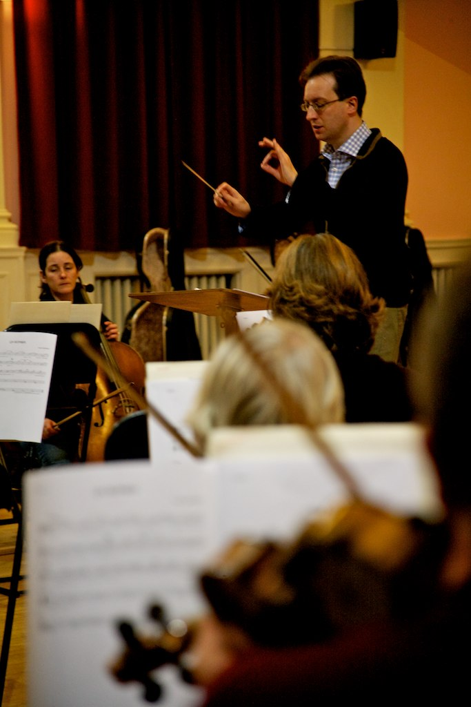
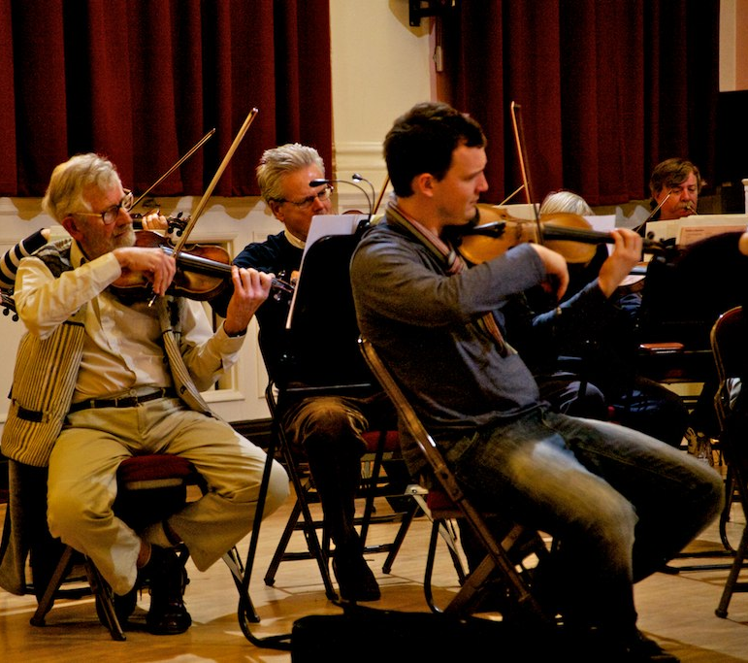


Haslemere Musical Society
Symphony Orchestra and Choir
Home
About Us
Join Us
Support Us
Concerts
Contact Us
Members
The Society
Gallery
Founded 90 years ago in 1923, the Haslemere Musical Society consists of a Symphony Orchestra and Chorus and has been a major contributor to the musical life of South West Surrey.
The Society has built a reputation for its high musical standards and for producing exciting and enjoyable concerts.
Next performance
May Concert
Rossini: Il Barbiere di Siviglia & Villagers’ Chorus: Guillaume Tell
Donizetti: Chorus of Wedding Guests: Lucia di Lammermoor
Gounod: Ballet Music: Faust Verdi: Anvil Chorus
Mascagni: Intermezzo and Easter Hymn: Cavalleria Rusticana
Puccini: Intermezzo: Manon Lescaut
Wagner: Pilgrim’s Chorus (Act I) and March (Act II): Tannhäuser
Wagner: Prelude to Act III and Bridal Chorus: Lohengrin
Wagner: Procession and Chorale: Act III: Die Meistersinger von Nürnberg
Saturday 4th May 2013, Haslemere Hall, 19:30
Frederic Handel
“Bringing music to the community”
© Haslemere Musical Society 2012
Contact us
Haslemere Challice Fund

Slide 2
Home
About Us
Join Us
Support Us
Concerts
Contact Us
Members
Home Page
The Society
New Members
Support Us
Concerts
Contact details
News
Musical Director
Come & Sing
Patrons
Reviews
Rehearsals
Chorus Master
Summer Sessions
Friends
Tickets
Practice music
Leader
Join now
Sponsors
Gallery
Fund raising
Pianist
Subscription
Donations
Links
Orchestra
Wills
Chorus
Past events

